Slide 1
Why you should invest in my game

Slide 2
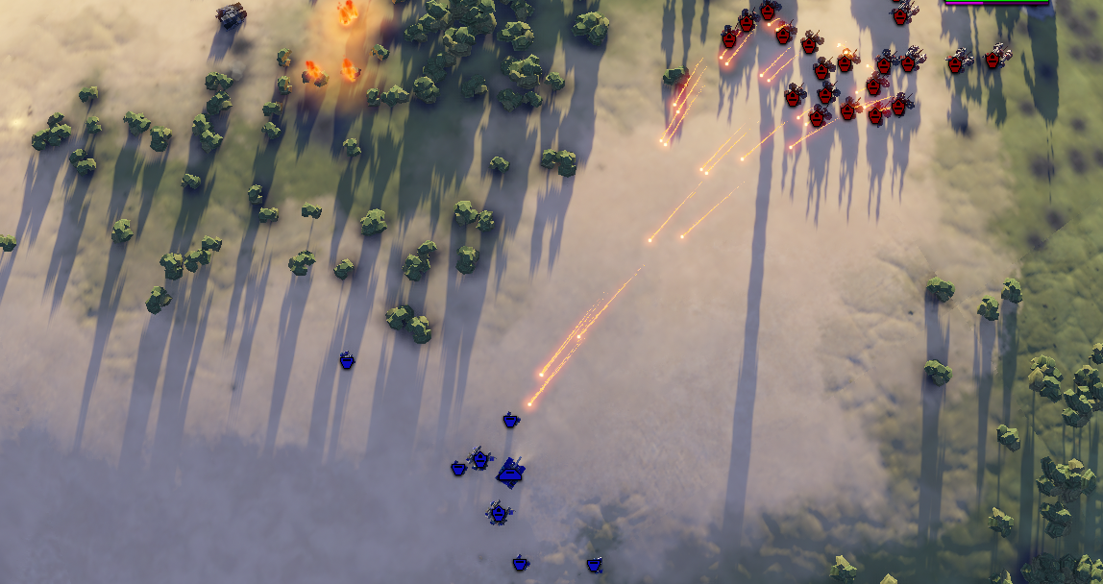
What is it?

Slide 3
Real Time Strategy
Often very complex
Steep learning curve
Can be somewhat overwhelming for beginners
Many things to keep track of

Slide 4
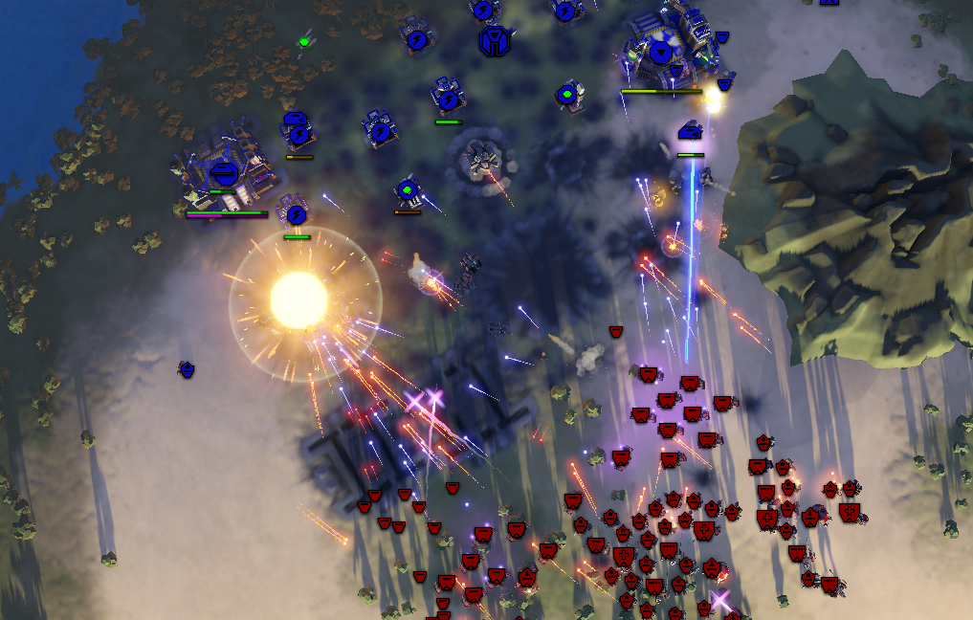
My approach

Slide 5
Easy to learn & Hard to master
Basic helpful automation
Intricate systems but simple on the surface
Simple controls
More abstract

Slide 6
Audience
All platforms
Any age
Wide demographic

Slide 7
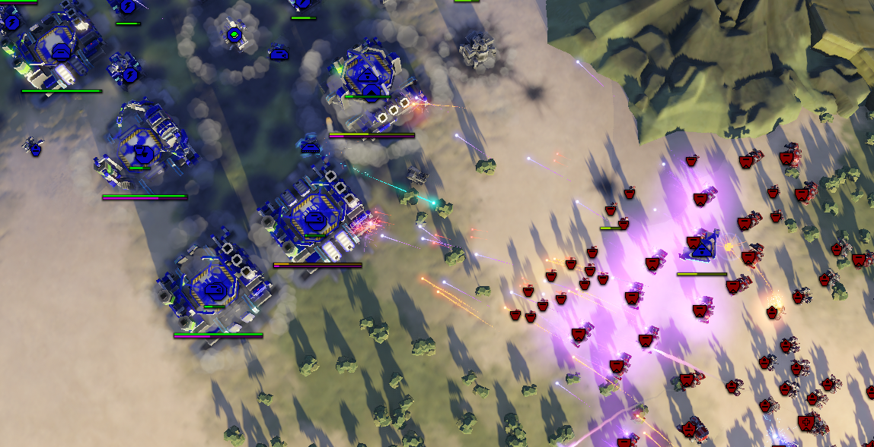
Financial Success

Slide 8
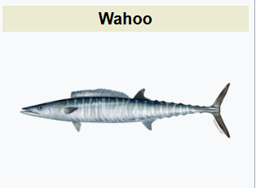
Key components
Large audience
Freemium model
Focus on player base expansion
Wahoo is our target consumer

Slide 9
Give me your money
(pretty please 🥺)

